Slide 1
Polymorphism
One function with different behaviors.
The ability to appear more than one form.
Without polymorphism we have to have different methods for different arguments.
There are two types of polymorphism, Compile time and Runtime.
Compile time polymorphism is achieved by Method Overloading. It is also known as Static Binding or Early Binding.
Run time polymorphism is achieved by Method Overriding. It is also known as Dynamic or Late Binding.
In simple words, when the child is not happy with parent implementation then the child can have their own implementation based on requirements. Bydefault the parent class methods are available to child classes.

Slide 2
To achieve Method Overriding we need two OR MORE THAN TWO classes.
The Classes must be in Parent and child relationship.
The child can override the methods already implemented by the parent class.
The Parent method is called overridden method, while the child class method is called overriding method.
For Method Overriding we need to follow 9 rules. Once all the rules are followed then the Overriding is completed.

Slide 3
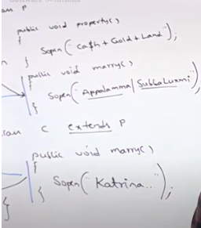
Method Resolution

Slide 5
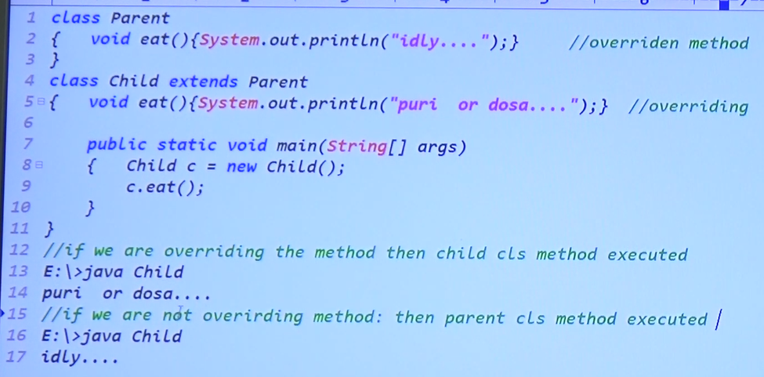

Slide 7
Rule 1
The Overridden and Overriding methods signatures must be same.
Once the Parent class overridden method is declared final then it cannot be overridden in the child class.

Slide 8
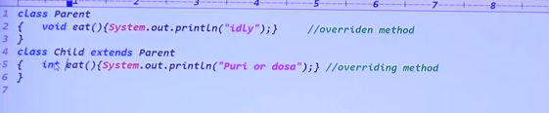
Rules 3 : The Return Types of the Overridden and Overriding Methods must be same
At Primitive level the return types must be same.

Slide 9
Rule 4: Case 1: Return types can be changed at class level.

Slide 10
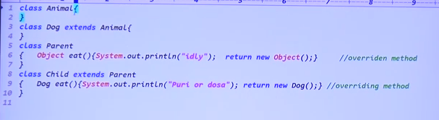
Case 2
Take Object class instead of Parent class then the code will also be valid. The

Slide 11
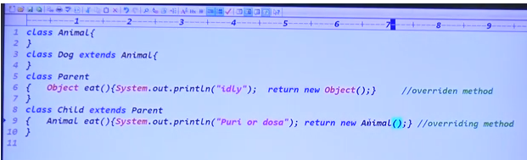
Case 3: Take Animal object in the child class

Slide 12
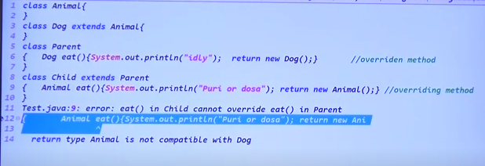
Case 4: The return type of child object cannot be possible with Parent class object.

Slide 13
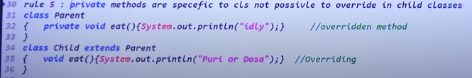
Rule 5: The Private Methods are not possible to override in child classes
Because the methods declared as private are specific to the class only.
While overriding it is not possible to decrease the permissions. However, you can increase the permissions.

Slide 14
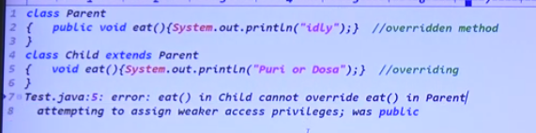
Rule 6:
The parent method is public, while the child method is default.
The public is accessible by all packages, while the default is accessible by only one package.
All packages to one package the permissions are reduced and it is not possible to reduce the permissions.

Slide 15
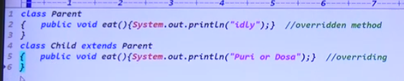
Case 1: Same level permissions both in parent and child class

Slide 16
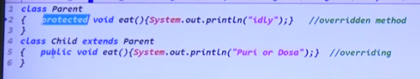
Case 2: Permissions are increased from parent to child

Slide 17
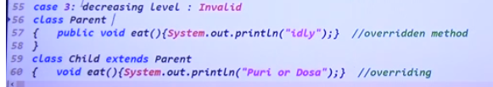
Case 3: Decreasing the level od permissions

Slide 18
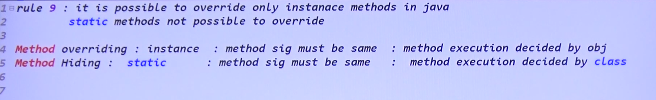
Rule 9: Only the Instance Methods are possible to override and not the Static Methods
There are two types of methods in java, instance and static.
The instance methods are accessed using the name of the instance object.
The static methods are accessed using the class name.

Slide 19
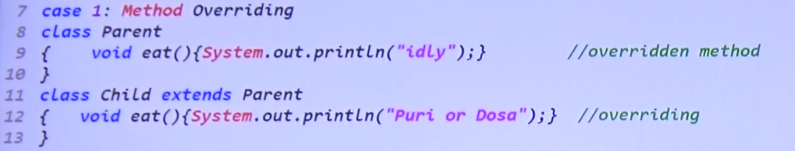
Case 1: Both Methods are instance methods

Slide 20
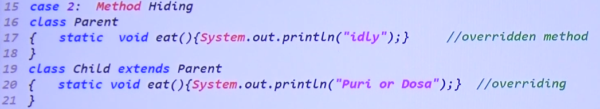
Case 2: Both methods are static, then this concept is Method Hiding, but not method overriding

Slide 21
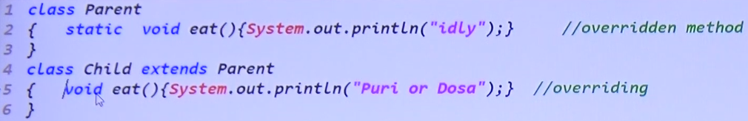
Case 3: One Method is instance and other is static, which is not allowed.

